Slide 1
Linear Programming
in Farm Planning
Team 2: Esme Li, Jacky Yang, Raj Patel

Slide 2
Table of Contents
01
02
03
04
05
06
Problem
Statement
Case
Description
Model
Analysis
Sensitivity
Analysis
Challenges
Discussion
Project
Conclusion

Slide 3
Problem Statement
Mission Statement:
Maximize the profit by considering all the factors that could influence the total profit, using a linear programming model in Python.
Motivations:
Achieve balance between resource utilization and revenue generation
Provide an overview of budget scope
Determine the most appropriate time to expand farm capacity

Slide 4
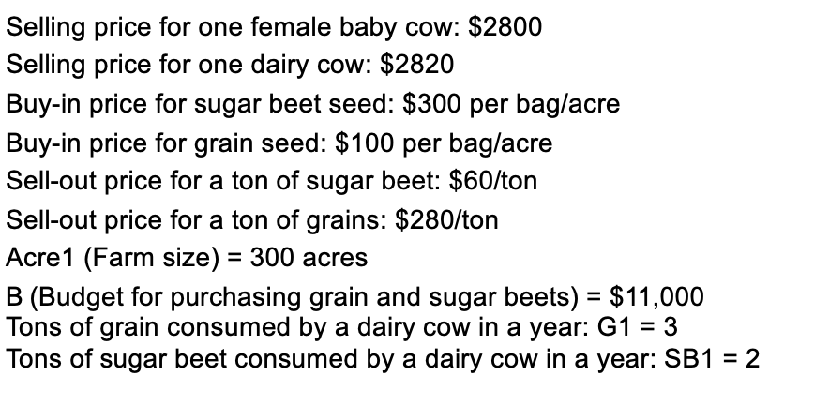
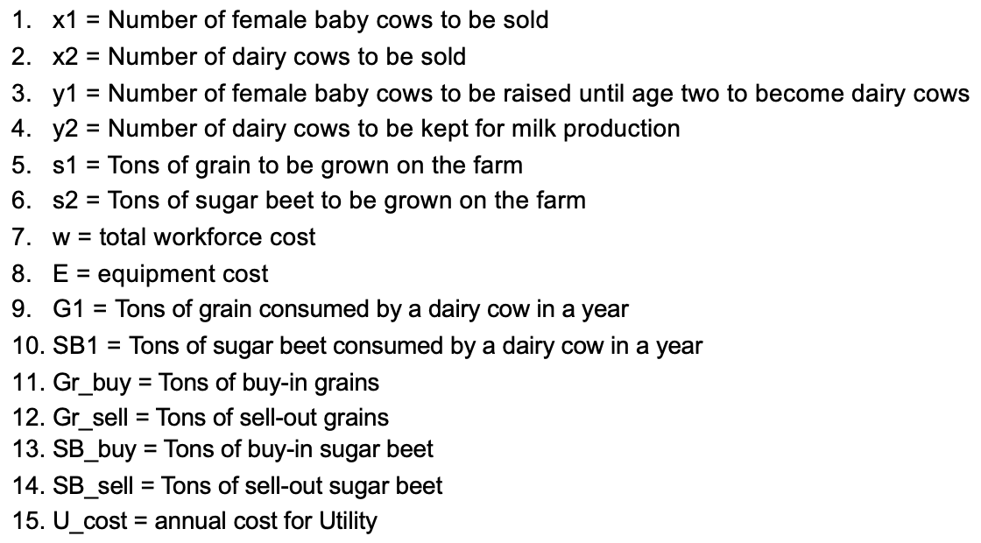
Farm Planning Case Description
Parameters:
Decision Variables:
Source:
https://github.com/Gurobi/modeling-examples/tree/master/farm_planning

Slide 5
Mathematical Model
Objective Function:
Total Revenue baby cow = # of female baby cow to be sold * selling price per female baby cow
Total Revenue dairy cow= # of dairy cow to be sold* selling price per dairy cow
Total Revenue Grain= amount of grain to be sold * price at which to be sold
Total Revenue Sugar Beets= amount of sugar beets to be sold * price at which to be sold
Total Grain Cost= Amount of grain to buy * price to buy grain per bag
Total Sugar Beet Cost= Amount of sugar beet to buy * price to buy sugar beet per bag
Total Operation Cost= Equipment cost + annual cost of utility + total workforce cost
Maximize Profit = Total Revenue - Total Costs

Slide 6
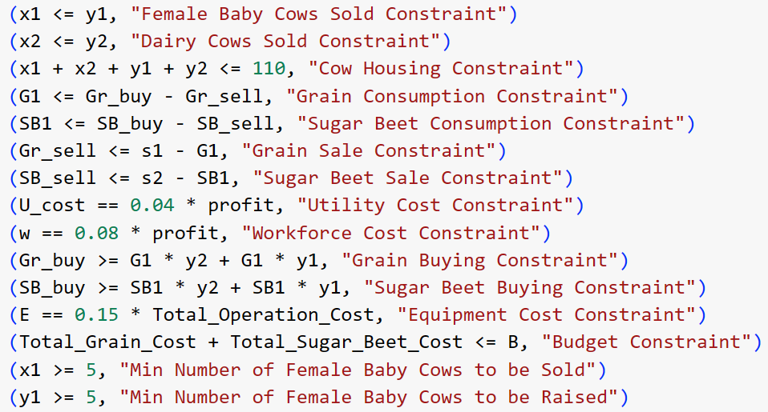
Mathematical Model
Constraints

Slide 7
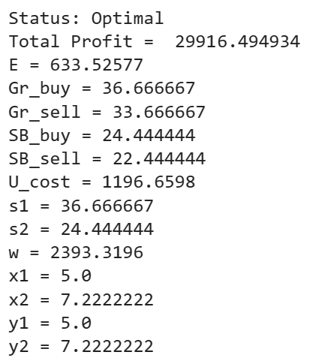
Optimal Solution
Base Case Result

Slide 8
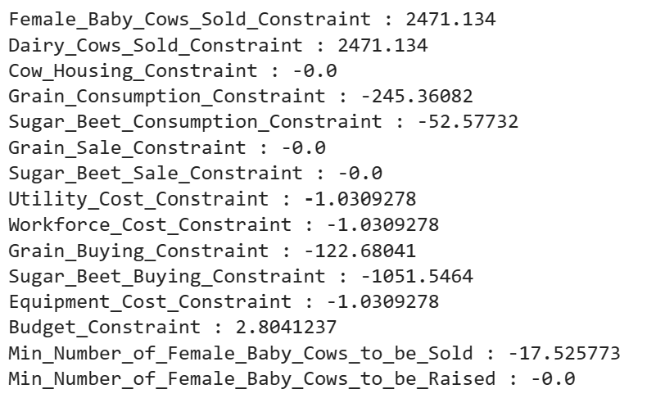
Sensitivity Analysis
Shadow Prices

Slide 9
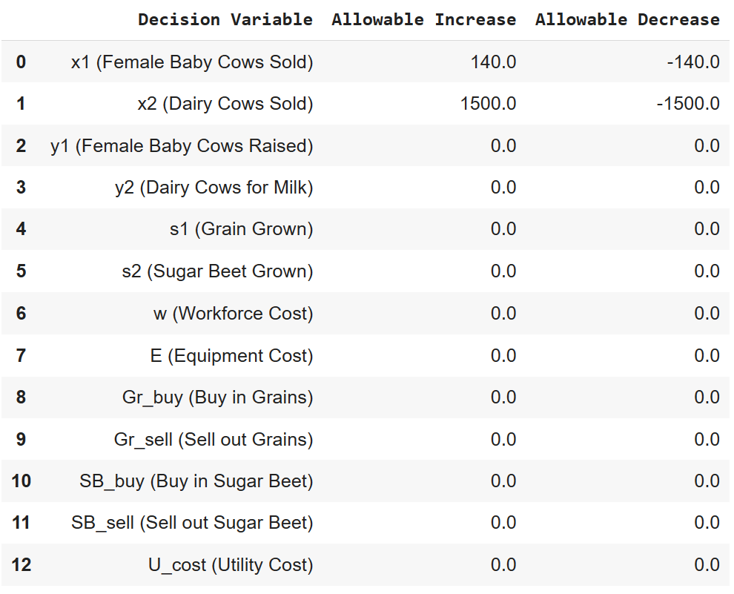
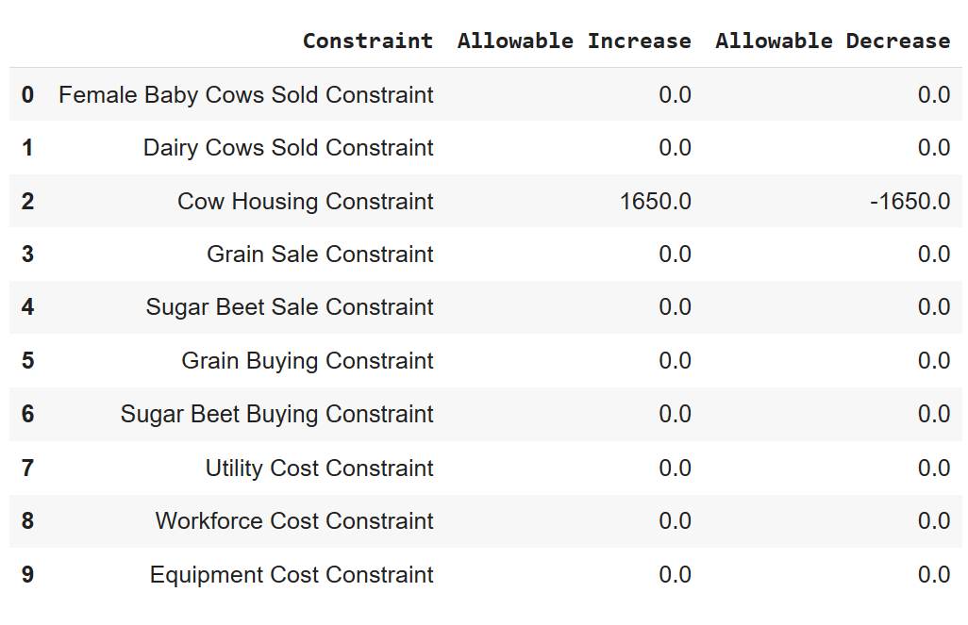
Sensitivity Analysis
Allowable Increase/Decrease:
Decision Variables:
Constraints:

Slide 10
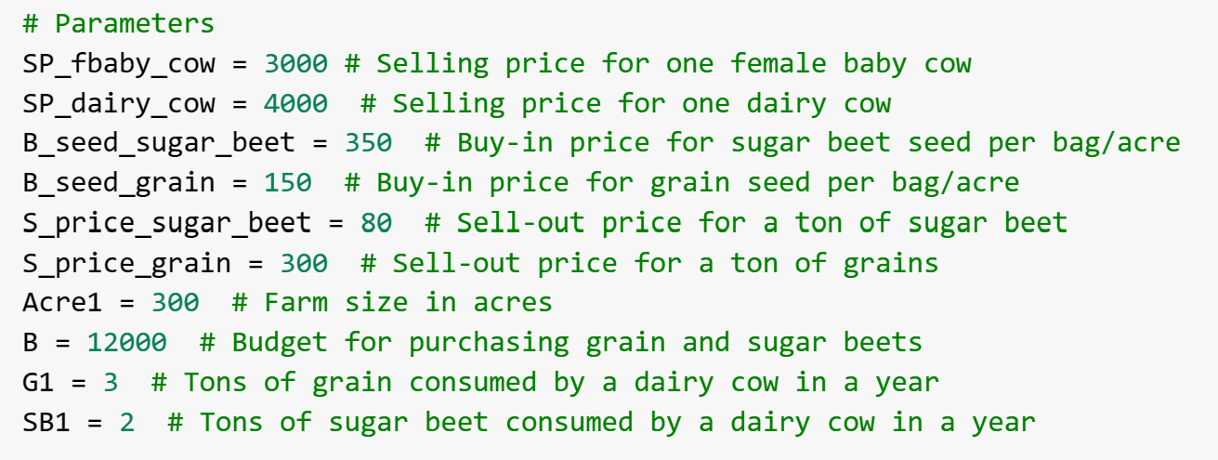
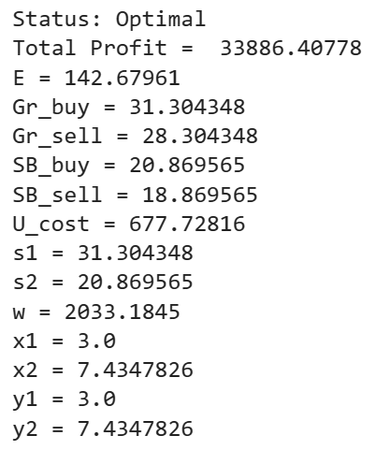
Discussion of Different Scenarios
Best Case Scenario:
Constraints
Constraints | Base | Best
Cow Housing | 110 | 150
Utility Cost | 4% | 2%
Workforce Cost | 8% | 6%
Equipement Cost | 15% | 5%
Min. # to be sold | 5 | 3
Min. # to be raised | 5 | 3

Slide 11
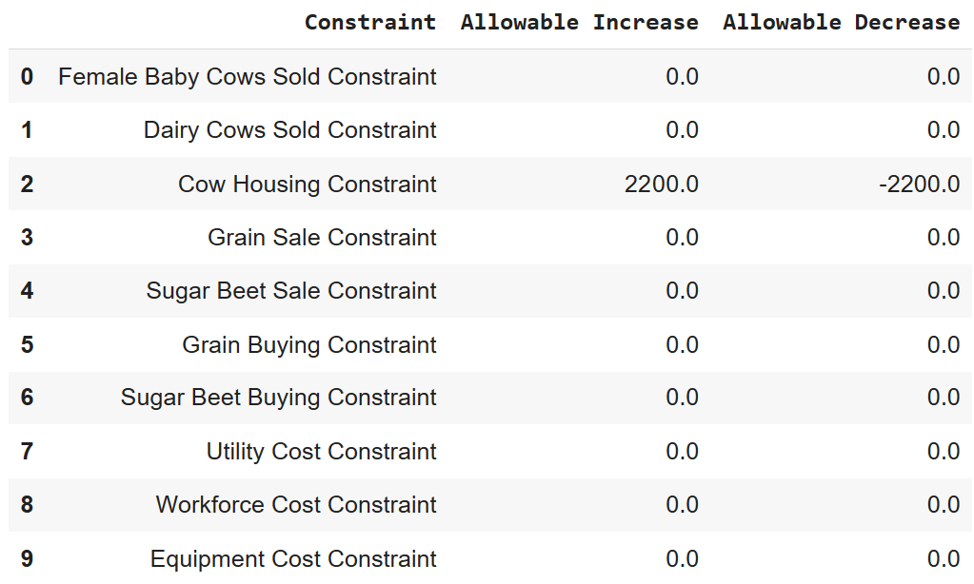
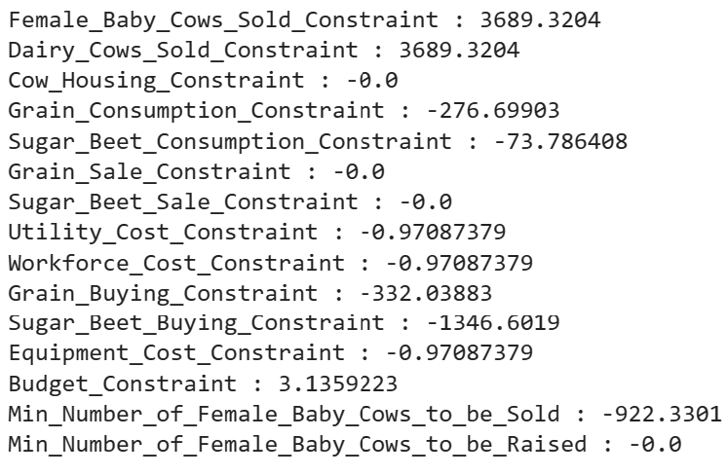
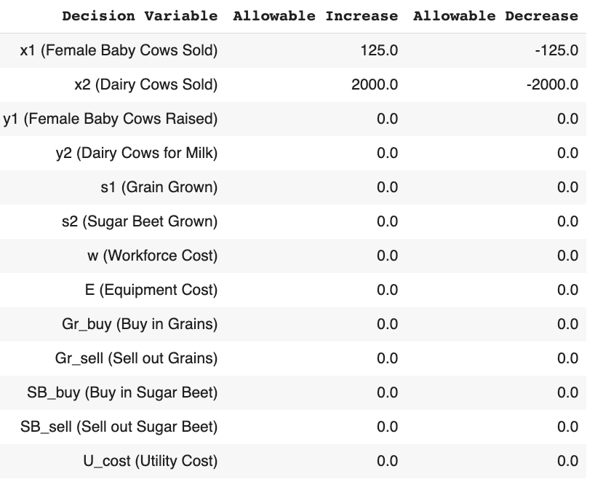
Discussion of Different Scenarios
Sensitivity Analysis:
Allowable Increase/ Decrease
Shadow Price

Slide 12
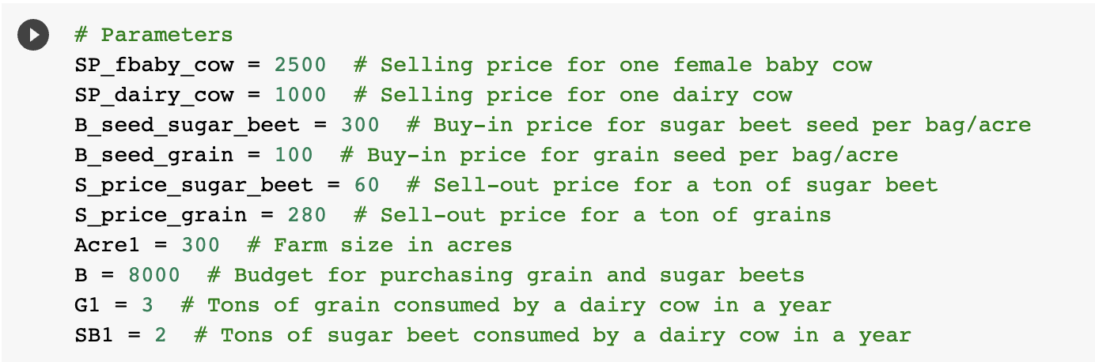
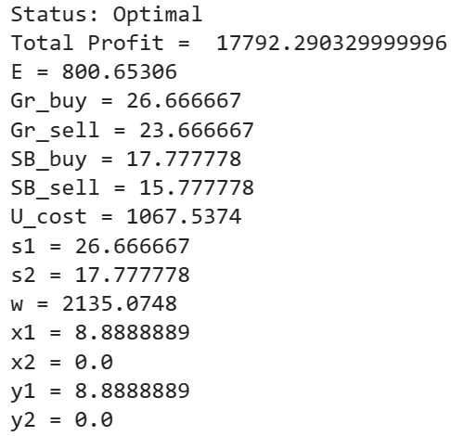
Discussion of Different Scenarios
Worst Case Scenario:
Constraints | Base | Worst
Cow Housing | 110 | 90
Utility Cost | 4% | 6%
Workforce Cost | 10% | 12%
Equipement Cost | 15% | 20%
Min. # to be sold | 5 | 5
Min. # to be raised | 5 | 7

Slide 13
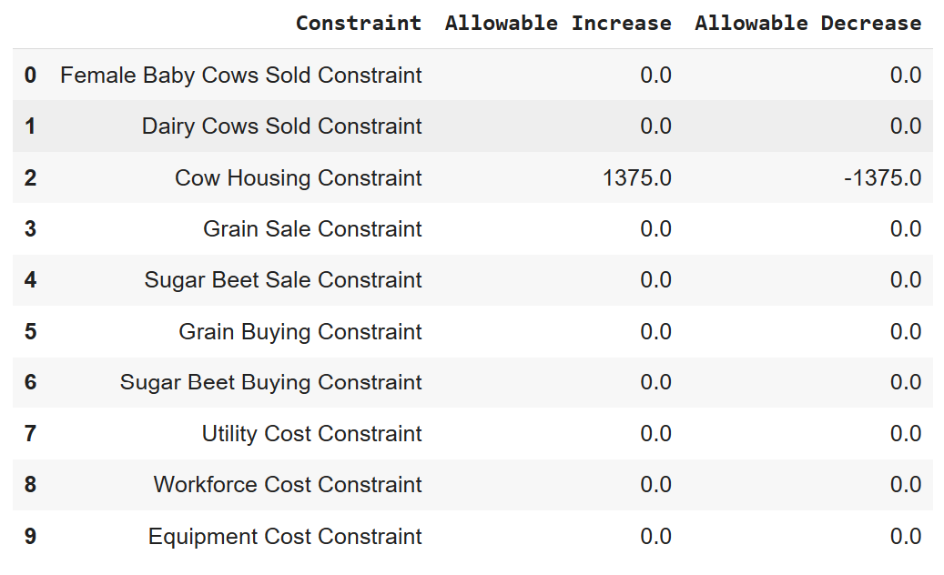
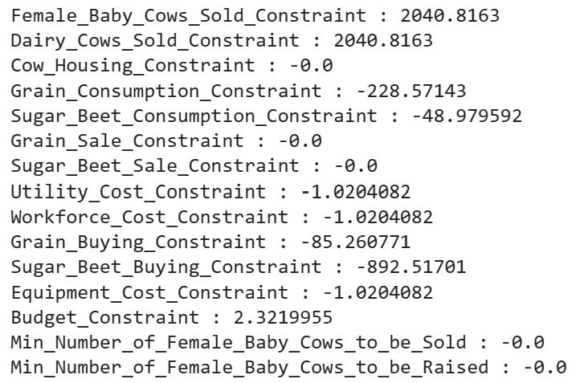
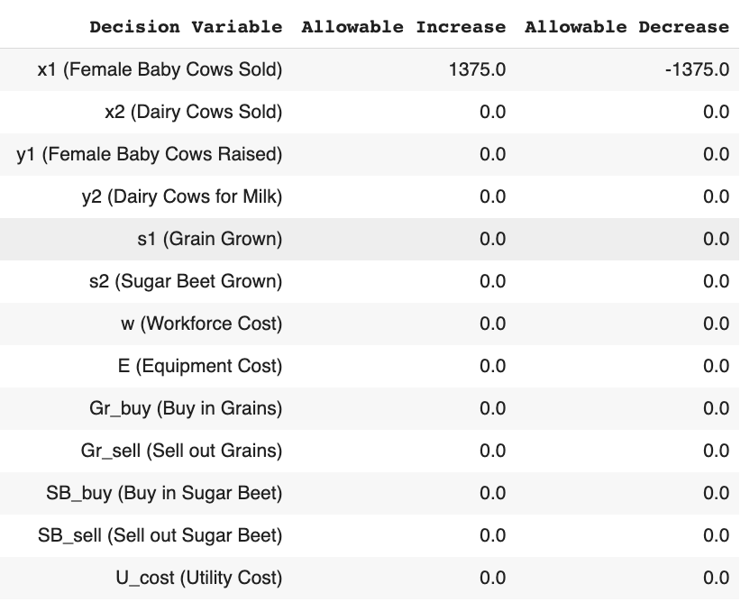
Discussion of Different Scenarios
Sensitivity Analysis:
Allowable Increase/Decrease
Shadow Price

Slide 14


Challenges We Faced
Linear & constraints limitation :
We discovered that the constraints must be linear
So we reformulate the problem so that all the constraints are linear
Adaptability to Real-time Changes:
The unpredictable nature of farming might introduce challenges the model didn't predict
We are trying our best to adjust the parameters and constraints to meet the real world

Slide 15

Conclusion
What have we learnt from this practice?
Informed Decisions: Using linear programming ensures comprehensive consideration of all profit-influencing factors, leading to smarter decisions.
Effective Budgeting: A clear budget overview enables efficient resource allocation and optimal financial management.
Timed Expansion: Identify and act on the right moments for farm growth, ensuring sustainable and strategic capacity increases.

Slide 16
Thanks &
Any Questions?

Slide 17
Work Cited
Google Collab Notebook:
https://colab.research.google.com/drive/1e1XURo7cnXsYWewTv0w5LMLwpXgVosXq?usp=sharing

Slide 18
Reference
Growthink. (Year). Farmers market business plan. https://www.growthink.com/businessplan/help-center/farmers-market-business-plan
Farmers Market Coalition. (2017). Willimantic Farmers Market Business Planning Guide. https://farmersmarketcoalition.org/wp-content/uploads/2017/01/Willimantic-Farmers-Market-Business-Planning-Guide.pdf
OGS Capital. (Year). Farmers market business plan template. https://www.ogscapital.com/article/farmers-market-business-plan-template/
Commonwealth of Massachusetts. (Year). How to run a farmer's market. https://www.mass.gov/guides/how-to-run-a-farmers-market

